Slide 1



Module 1. Lesson 4.
Nested
data structures
Link to guidelines

Slide 2

Module 1. Lesson 4. Nested data structures
ProTeam hackathon
Discussion:

Slide 3
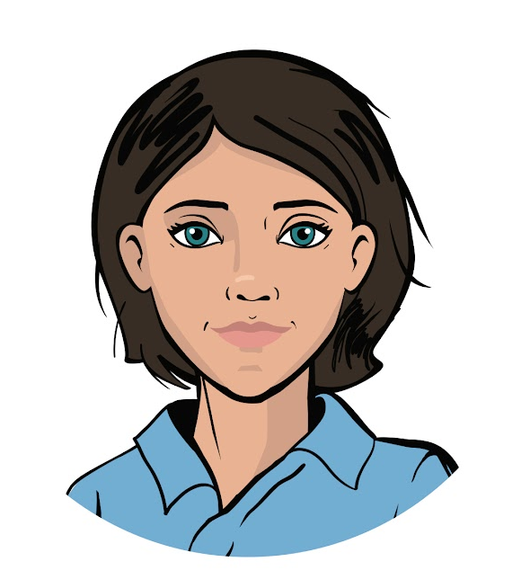

We have an announcement!
A programming hackathon will take place today at ProTeam.
The goal of the hackathon is to program a storage system for our ProTeam employees.
Colleagues, you have been developing software for a long time. This is a great chance to prove yourself!
Discussing
work tasks
Emily,
project manager

Slide 4
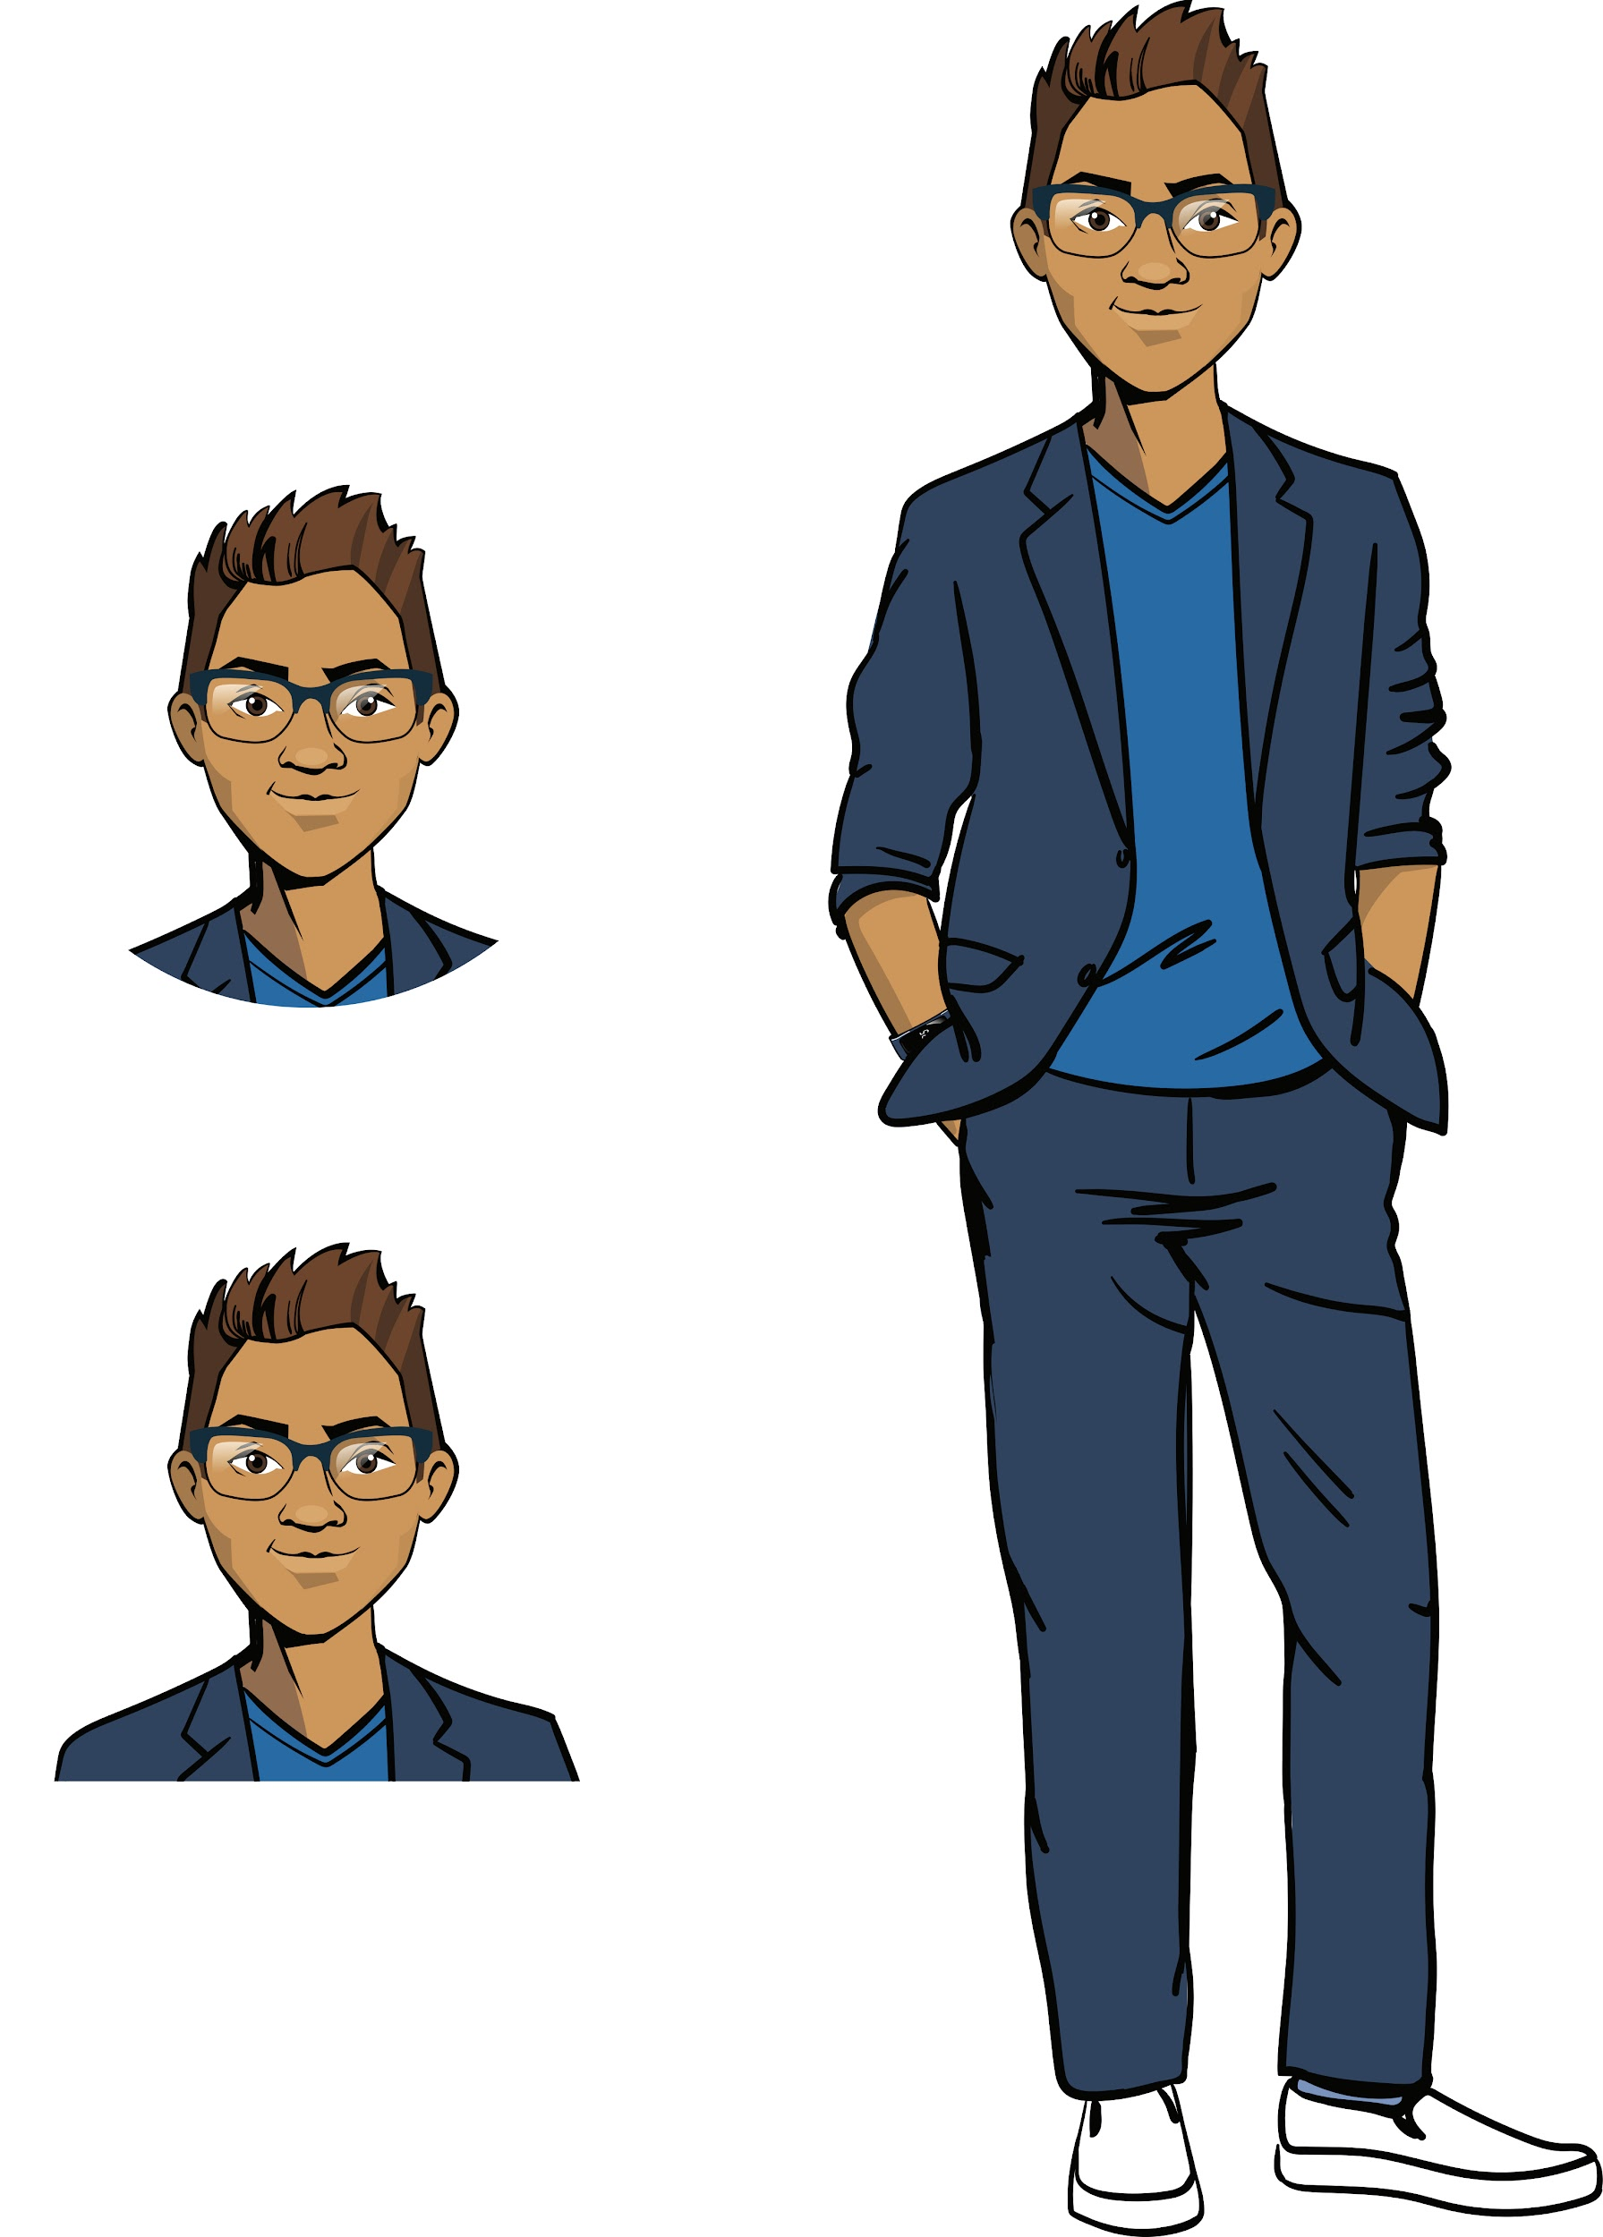
We have an announcement!
Moreover, ProTeam needs tiered data storage. Such a project requires knowledge of all the intricacies of using data structures.
Let's consider one possible task.
Discussing
work tasks
Cole,
senior developer

Slide 5
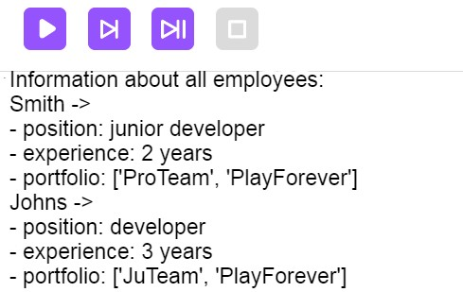
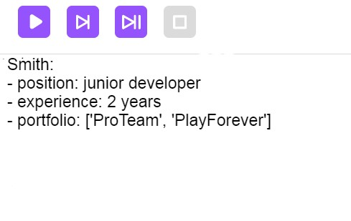
Let’s look at the task
The task. Program an employee database for the web development department.
The database should store the following set of data about each employee:
position,
experience,
portfolio (project names).
This data must be available by the employee’s name.
Discussing
work tasks
Information about one employee
Information about all employees

Slide 6
Let’s look at the task
The task. Program an employee database for the web development department.
The database should store the following set of data about each employee:
position,
experience,
portfolio (project names).
This data must be available using the employee’s name.
The web development department
Discussing
work tasks
Name1
Name2
Position
Experience
Portfolio
Position
Experience
Portfolio

Slide 7
Let’s look at the task
The task. Program an employee database for the web development department.
The database should store the following set of data about each employee:
position,
experience,
portfolio (project names).
This data must be available using the employee’s name.
staff = {
'Smith' :{
'Должность' : 'младший разработчик',
'Опыт' : 2,
'портфолио': ['Сайт Долголетие', 'Сайт PlayForever']
}
}
Name
Discussing
work tasks
Position
...
Experience
Portfolio
...
...
workers ['Smith' ]
Getting information by name
Name

Slide 8
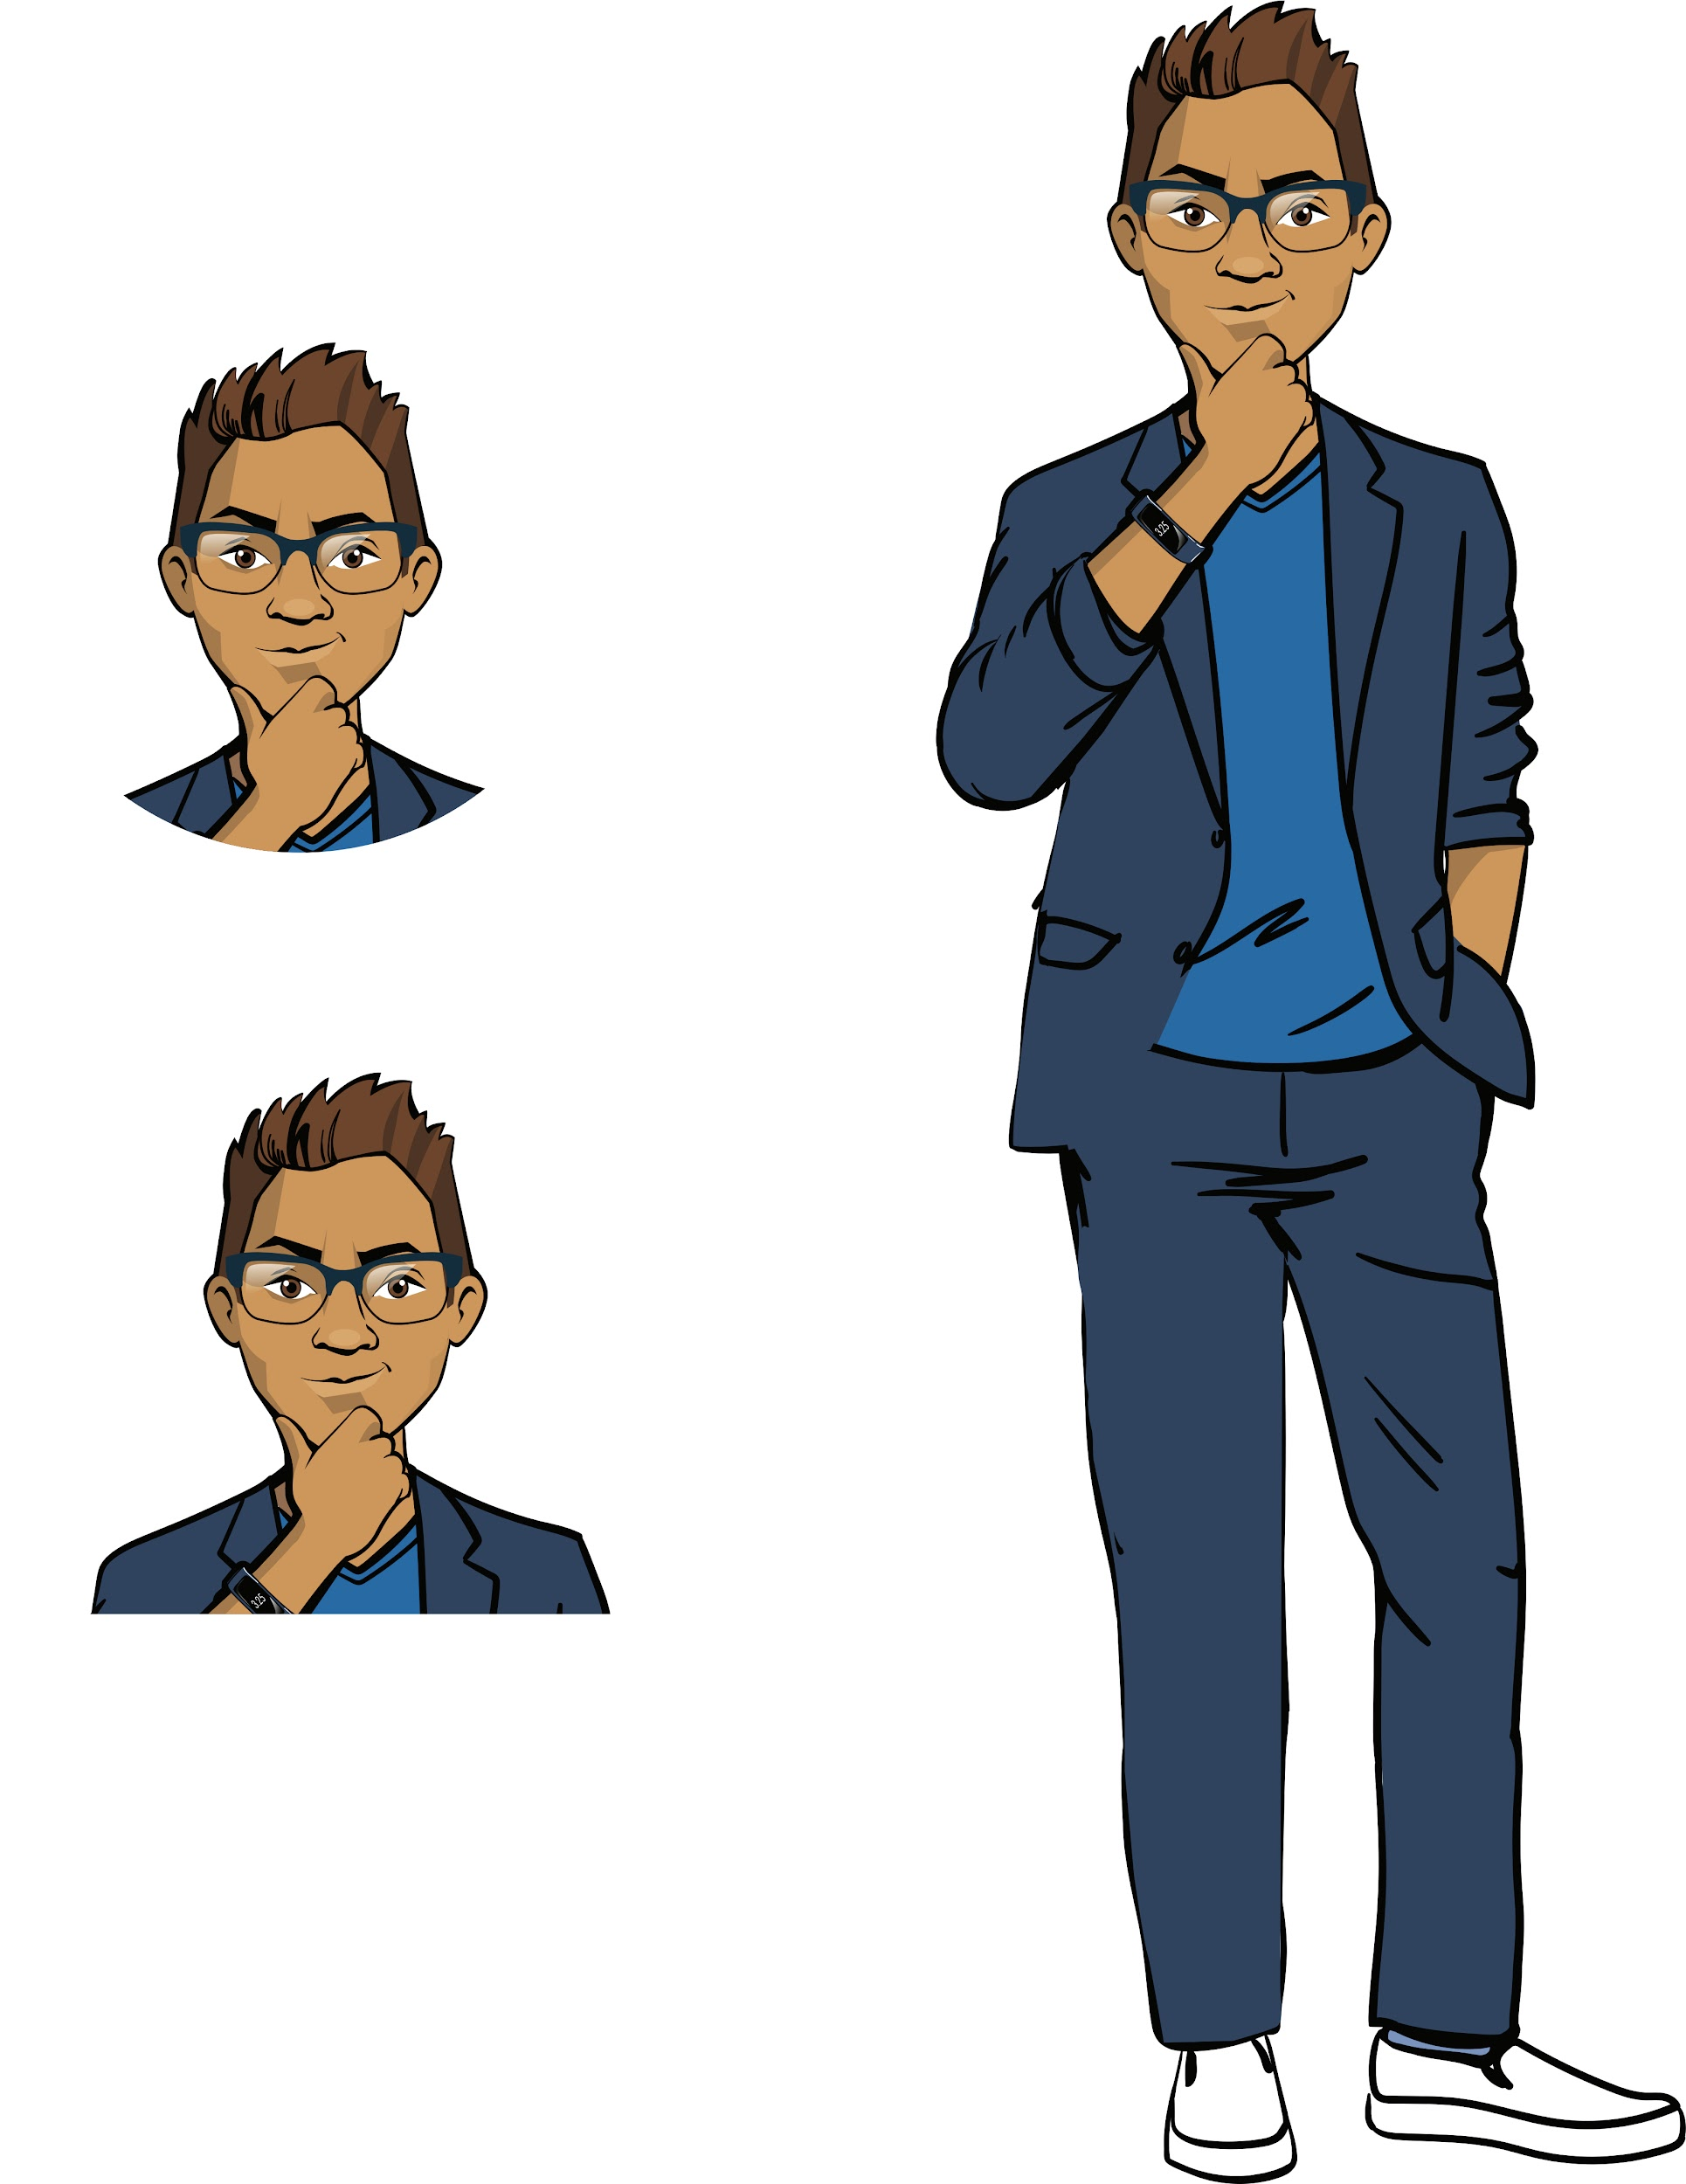
Nested structures
The solution we’re considering uses a nested data structure: a dictionary with dictionaries.
This solution is not fundamentally new, but working with it requires real skill.
To develop your skills and participate in the hackathon successfully, you will need to go through some special training.
Discussing
work tasks

Slide 9
The goal of the work day is
learn how to program nested data structures.
This will be useful not only for the hackathon, but also for the development of your professional skills.
Today you will
figure out how to use one data structure inside another;
take a training course;
take part in the ProTeam hackathon.
Discussing
work tasks

Slide 10

Module 1. Lesson 4. Nested data structures
Qualifications

Slide 11
To start the training, first show
your level of knowledge!
Qualifications

Slide 12
What data types do you know?
Qualifications

Slide 13
What data types do you know?
We know five types of data:
Data types | Examples
Integers (int) | 1, -10, 100, (-5 + 4)
Decimals (float) | 3.14, -164.3, 700.0, (100 * 0.95)
Boolean values (bool) | True, False, (10 >= 99), (‘ok’ == pass and 5 != count)
Lists (list) | names = list(), results = [81.2, 67.0], students = ['Johns', 'Hobbs']
Dictionaries (dict) | data = dict(), reader_card = {num: 421, surname: 'Perkins'}
Qualifications

Slide 14
What is an immutable data type?
Which data types are immutable and which are not?
Qualifications

Slide 15
Kinds of data types:
Data types
Immutable types
Mutable types
Qualifications
Cannot be changed programmatically:
integers,
decimals,
strings
Can be changed programmatically:
lists,
dictionaries.

Slide 16
What is a dictionary?
What data is stored in a dictionary?
Qualifications

Slide 17
A dictionary is an unordered set of key-value pairs.
Dictionary declaration:
books = dict() #empty dictionary
books = {'poem': 'Romeo and Juliet', 'fairy tale': 'nicholas nickelby'}
Qualifications
Key
Value
Key
Value
Getting an item by key:
genre = input('Enter a genre:')
print('Recommendation:', books[genre])

Slide 18
What actions you can perform with dictionaries?
Qualifications

Slide 19
What actions you can perform with dictionaries?
Determine the length of a dictionary
Get an item from a dictionary using a key
Qualifications
Search for a key in a dictionary
Add a key-value pair to a dictionary
Delete a key and its value
from a dictionary

Slide 20
What commands correspond to those actions?
Determine the length of a dictionary
?
Get an item from a dictionary using a key
?
Qualifications
Search for a key in a dictionary
?
Add a key-value pair to a dictionary
?
Delete a key and its value
from a dictionary
?

Slide 21
What commands correspond to those actions?
Determine the length of a dictionary
len(readers)
Get an item from a dictionary using a key
readers['Smith']
Qualifications
Search for a key in a dictionary
'Smith' in readers
Add a key-value pair to a dictionary
readers['Smith'] = 'Jackson'
Delete a key and its value
from a dictionary
del readers['Smith']

Slide 22

Qualifications confirmed!
You are ready to train and improve your
developer skills!
Qualifications

Slide 23

Module 1. Lesson 4. Nested data structures
Training:
Nested
data structures

Slide 24
Nested data structures
The training on nested data structures will consist of two parts: theoretical and practical.
Key questions:
What data structures can be nested?
Where can data structures be nested?
Are there any restrictions on the nesting degree?
Brainstorming
Cole,
senior developer

Slide 25
Lists
Rule: a list item can be an object of any type.
Examples:
staff = ['Johns', 'Swift']
staff = [
{'Johns': 'programmer'},
{'Swift': 'tester'}
]
staff = ['Johns', ['ProTeam', 'PlayForever']]
staff = [
{'Johns': ['ProTeam', 'PlayForever']},
{'Swift': ['ProTeam']}
]
Brainstorming

Slide 26
Lists
Rule: a list item can be an object of any type.
Examples:
staff = ['Johns', 'Swift']
staff = [
{'Johns': 'programmer'},
{'Swift': 'tester'}
]
staff = ['Johns', ['ProTeam', 'PlayForever']]
staff = [
{'Johns': ['ProTeam', 'PlayForever']},
{'Swift': ['ProTeam']}
]
List items can be:
lists,
lists of lists,
dictionaries,
dictionaries with list values
etc.
Brainstorming

Slide 27
Dictionaries
Rule:
A key can only be an immutable type object.
A value can be an object of any type.
Examples:
staff = {
'Johns': 'programmer',
'Swift': 'tester'
}
staff = {
'Johns': ['ProTeam', 'PlayForever'],
'Swift': ['ProTeam']
}
staff = {
'Johns': {
'experience': '3',
'position': 'programmer'
},
'Swift': {
'experience': '2',
'position': 'manager'
}
}
Brainstorming

Slide 28
Dictionaries
Rule:
A key can only be an immutable type object.
A value can be an object of any type.
Examples:
staff = {
'Johns': 'programmer',
'Swift': 'tester'
}
staff = {
'Johns': ['ProTeam', 'PlayForever'],
'Swift': ['ProTeam']
}
A dictionary key can be:
numbers,
strings.
A dictionary value can be:
numbers,
strings,
lists,
dictionaries,
lists of lists,
lists of dictionaries,
etc.
Brainstorming

Slide 29
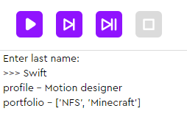
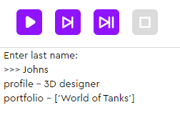
Let’s look at the task
The task. Program a structure for storing the design department’s data. When running the program, a last name is requested as input.
If that last name is found, the following information is displayed:
profile,
portfolio.
Brainstorming

Slide 30
Let’s look at the task
The task. Program a structure for storing the design department’s data. When running the program, a last name is requested as input.
If that last name is found, the following information is displayed:
profile,
portfolio.
How should such a structure be arranged?
How do we get a profile and portfolio by the designer’s last name?
Brainstorming

Slide 31
Let’s look at the task
The task. Program a structure for storing the design department’s data. When running the program, a last name is requested as input.
If that last name is found, the following information is displayed:
profile,
portfolio.
designers = {
'Smith' :{
'Должность' : 'младший разработчик',
'портфолио': ['Сайт Долголетие', 'Сайт PlayForever']
}
}
Last name
Brainstorming
Profile
...
Portfolio
...
...
designers['Smith' ]
Getting information by the last name
Last name

Slide 32
Let’s look at the task
The task. Program a structure for storing the design department’s data. When running the program, a last name is requested as input.
If that last name is found, the following information is displayed:
profile,
portfolio.
designers = {
'Johns': {
'profile': '3D designer',
'portfolio': ['World of Tanks']
},
'Swift': {
'profile': 'Motion designer',
'portfolio': ['NFS', 'Minecraft']
}
}
Brainstorming
How do we get the profile of a specific designer?
Portfolio?

Slide 33
designers = {
'Johns': {
'profile': '3D designer',
'portfolio': ['World of Tanks']
},
'Swift': {
'profile': 'Motion designer',
'portfolio': ['NFS', 'Minecraft']
}
}
surname = input('Enter last name:')
for info in designers[surname]:
print(info, '-', designers[surname][info])
Brainstorming
For each designer parameter:
display: parameter — its value.
designers['Johns']['profile']
3D designer
designers['Swift']['portfolio']
['NFS', 'Minecraft']

Slide 34
Before proceeding:
What will the previous program output if you request data?
designers['Swift']['portfolio'][1],
designers['Swift']?
What will the program output if you ask for a name that isn’t in the database, for example, “Morrissey”?
How can we improve the program so that it
reacts appropriately to the situation in
number 2?
Brainstorming

Slide 35
Conclusions:
A structure can be nested within another data structure. There are no restrictions on the degree of nesting.
An important restriction for dictionaries:
Inside a dictionary, a list cannot be used as a key - it should be used only as a value!
Brainstorming

Slide 36

Module 1. Lesson 4. Nested data structures
Platform:
Training

Slide 37




Complete tasks on the platform
Training
learn.alg.academy
Nested
data structures

Slide 38

Break

Slide 39
Module 1. Lesson 4. Nested data structures
ProTeam hackathon
Discussion:

Slide 40
Hackathon task
The goal is to program a ProTeam employees’ data storage system.
Information that’s considered important:
Last name.
Position.
Performance factor.
Names of the last three projects.
After programming the system, add three employees to it and configure output on request:
The last names of all employees.
The last name of the employee with the best performance.
The positions of all employees.
Discussing the
hackathon
Emily,
project manager

Slide 41
Hackathon task
Use the brainstorming materials!
workers = {
'Smith' :{
'Должность' : 'младший разработчик',
'портфолио': ['Сайт Долголетие', 'Сайт PlayForever']
}
}
Name
Info1
...
Info2
...
...
Discussing the
hackathon
workers['Smith' ]
Name
Getting information by last name
workers['Johns']['профиль']
Name
Info1
workers['Swift']]['портфолио']
Name
Info2
Emily,
project manager

Slide 42
Time allocation
Time | What happens
Start of Hackathon
20 minutes | Completing the task in the Laboratory
10 minutes | Posting the solution in the Laboratory, commenting on and evaluating the work of other participants.
End of Hackathon
10 minutes | Technical questions, summing up
Discussing the
hackathon

Slide 43
Module 1. Lesson 4. Nested data structures
Laboratory:
Hackathon

Slide 44
Complete the task in the Laboratory
Hackathon
learn.alg.academy
Hackathon

Slide 45

Module 1. Lesson 4. Nested data structures
End of the
work day

Slide 46

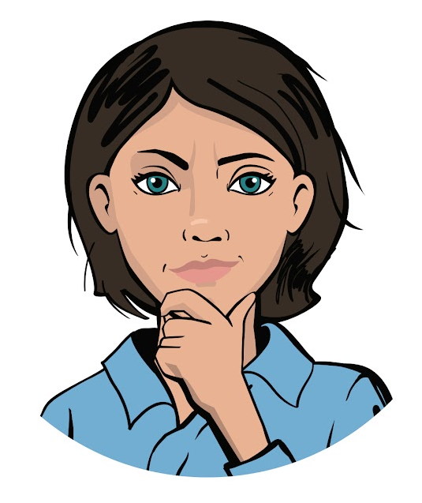
Let’s end the hackathon by
answering these technical questions:
What data structures do you know? What structure can we use inside another?
Are there any restrictions on using nested structures? What are they caused by?
Summing up
the work day
Cole,
senior developer
Emily,
project manager

Slide 47
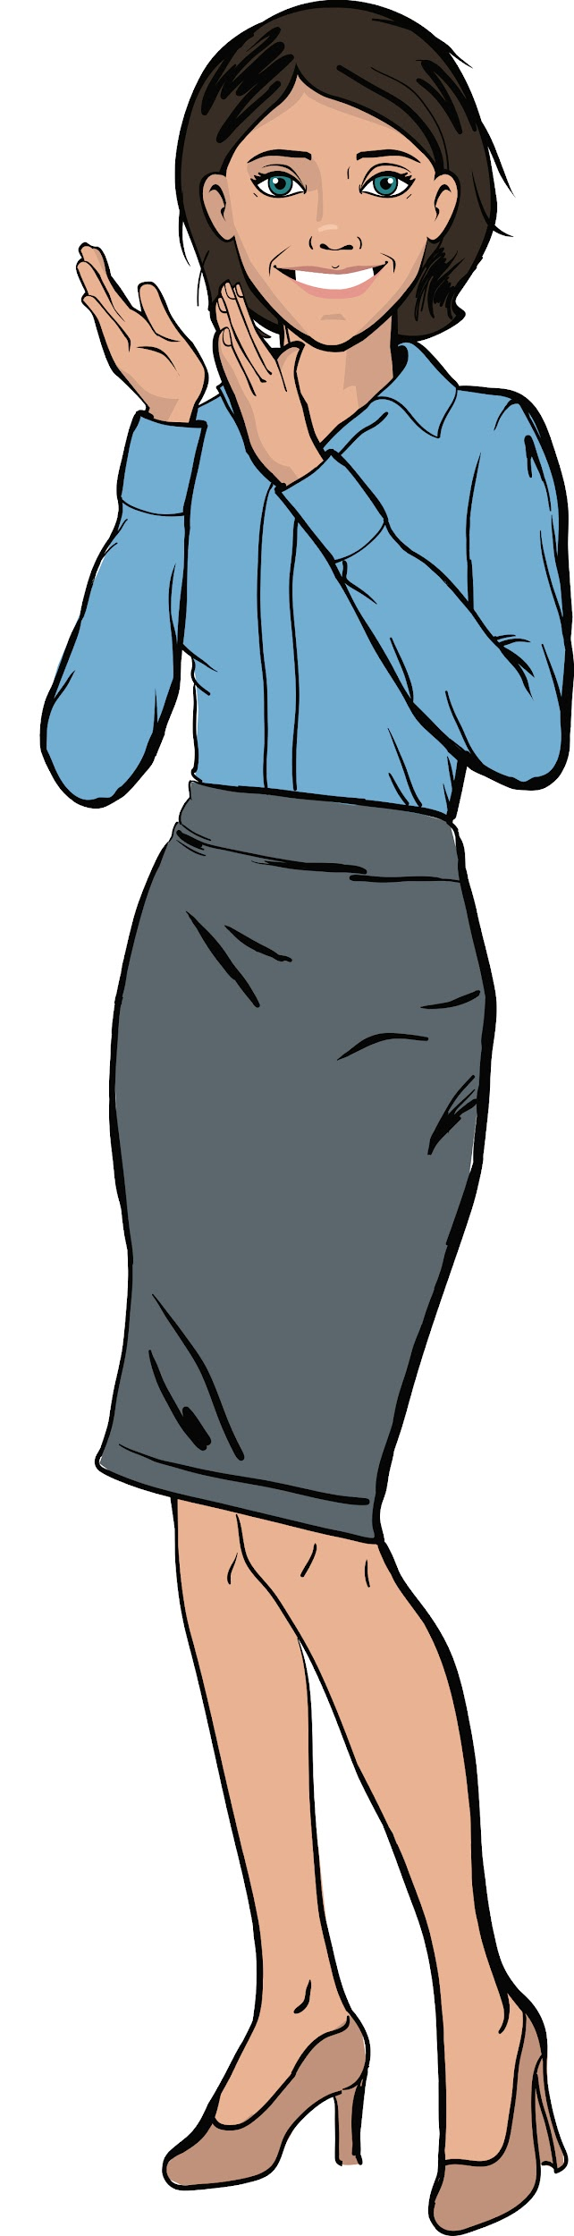
Great job!
Excellent work, colleagues!
Congratulations on your success in the ProTeam hackathon.
All your developments will be passed on to the engineers. Since each of you has contributed to the common cause, you are all awarded diplomas.
Summing up
the work day

Slide 48
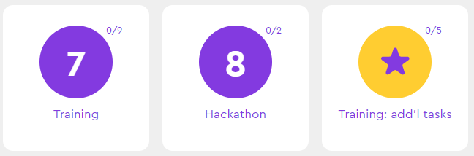
Additional tasks to improve your performance
Training:
add’l tasks
Summing up
the work day

Slide 49
Important announcement!
Starting from the next lesson, we will work not only on the platform, but also in the professional VSC code editor.
In the lessons, we will use the version of VSC integrated with the Algorithmics platform.
Installation instructions:
MS Windows ⬧ MacOS ⬧ Linux
Завершение урока

Slide 50
Share projects with other students
Hall of Fame

Slide 51
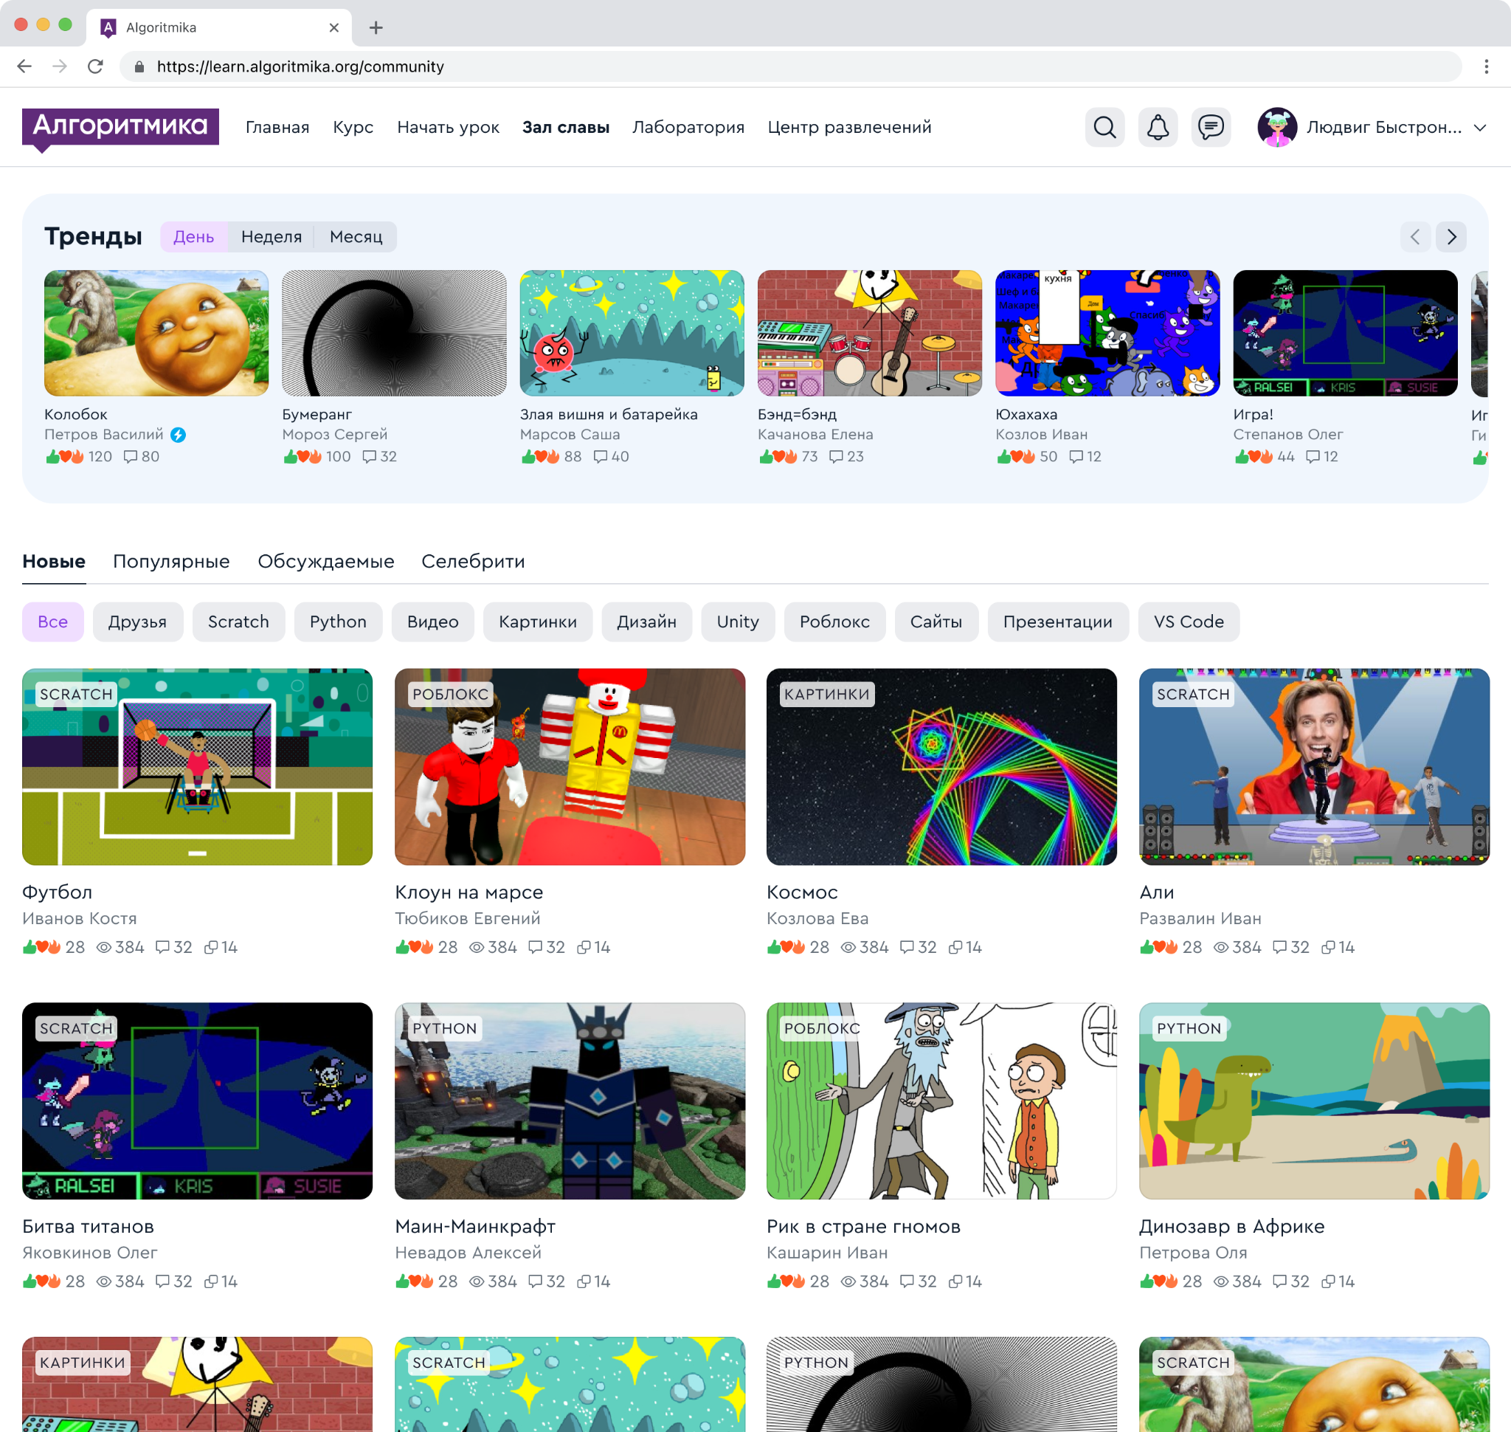
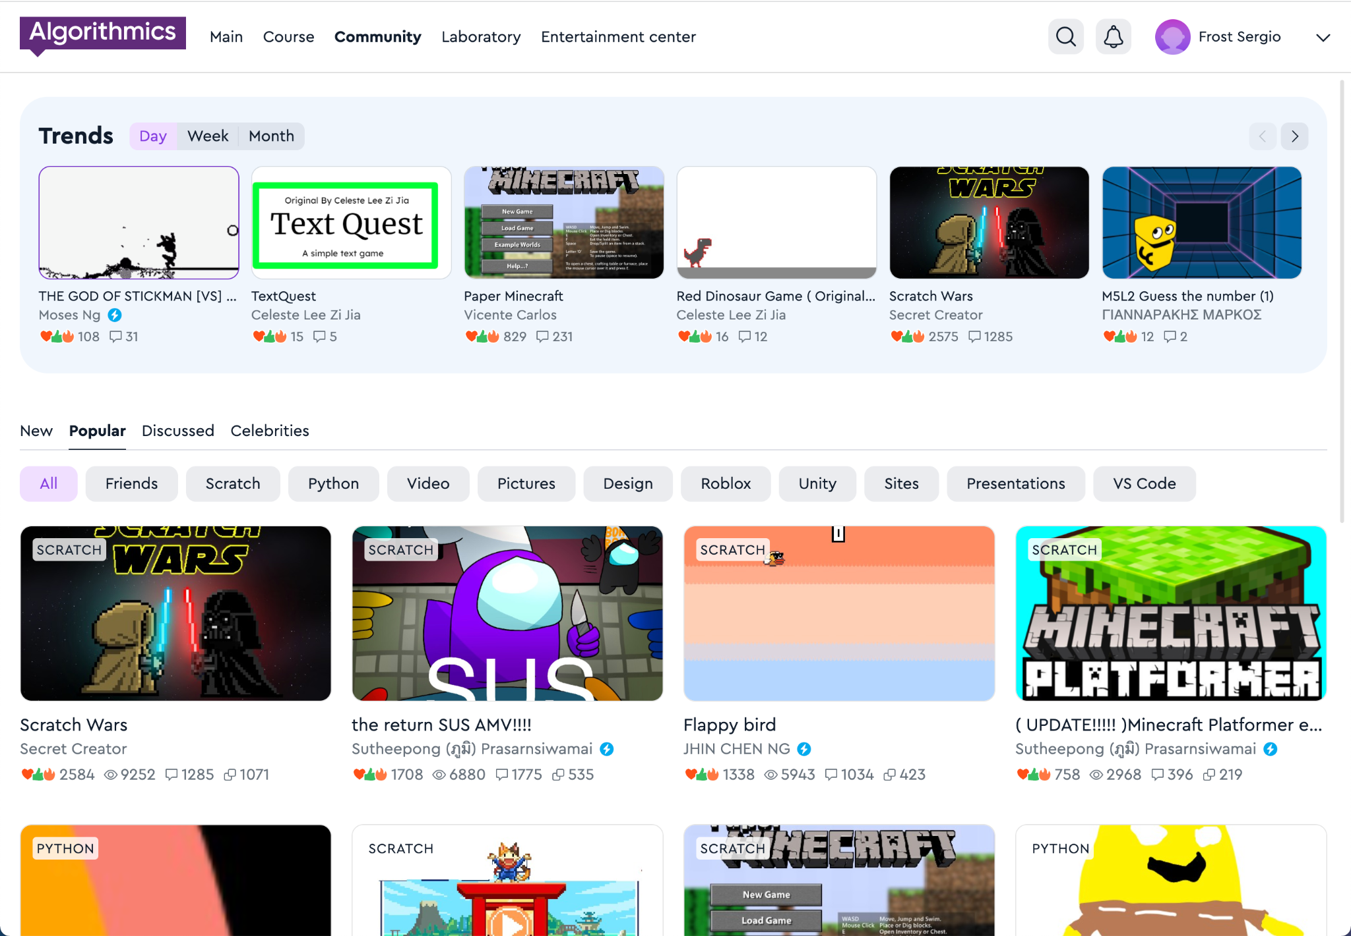
Hall of Fame
A space where our guys share projects, games, and ideas with each other.
In the Hall of Fame, the guys communicate and compete with each other
Hall of Fame

Slide 52
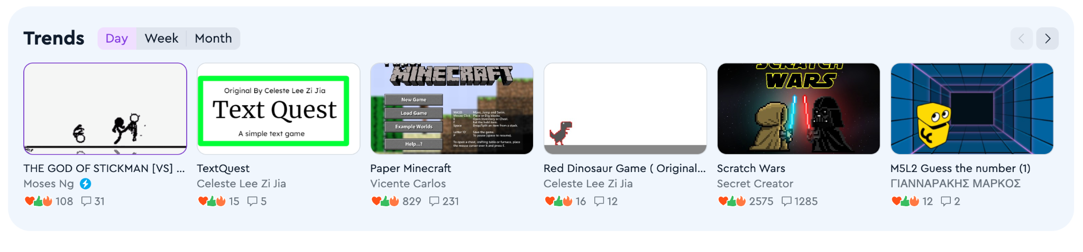
Trends
A block with new projects that are gaining popularity. The projects in this block help to understand what is happening in the Hall of Fame.
The trends reflect the projects that have the most likes and comments per day, week or month.
Hall of Fame

Slide 53
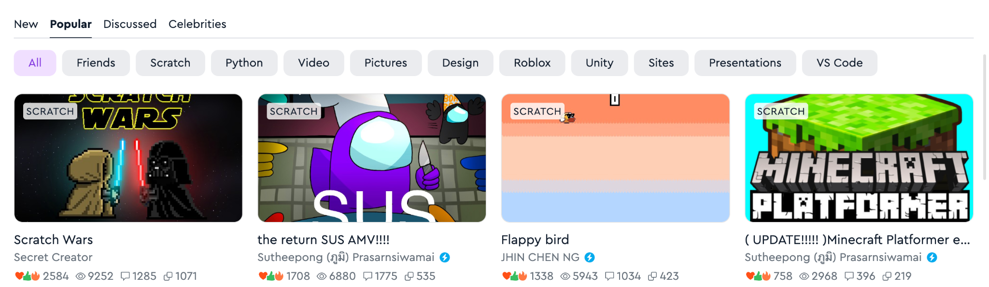
Viewing projects
Projects are displayed by newness, popularity and number of comments, and you can also view projects of "Celebrities", friends, and projects on individual subjects
Hall of Fame

Slide 54
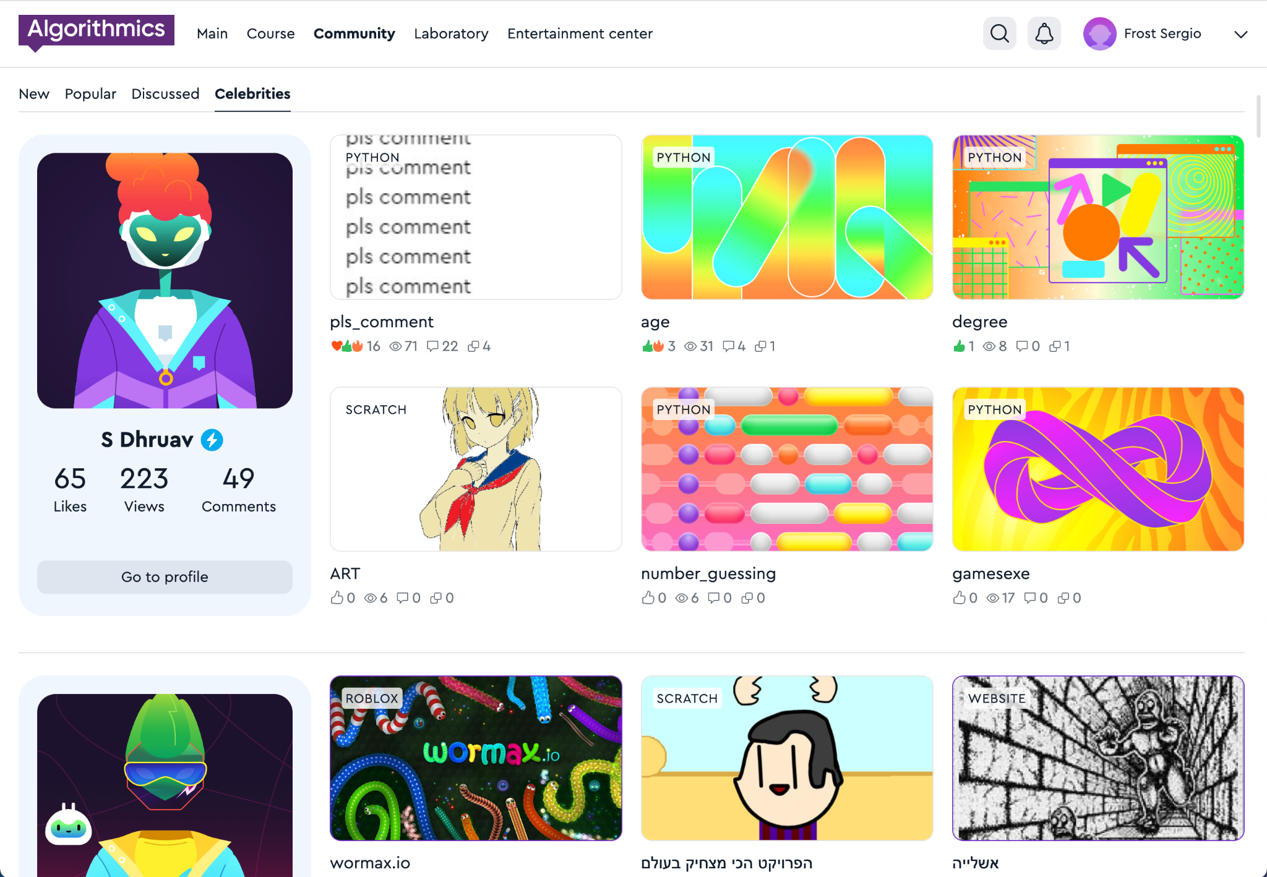

Celebrity
Students who make cool projects and win competitions receive a special status: "Celebrity".
A student who has received celebrity status receives a blue badge
Hall of Fame

Slide 55
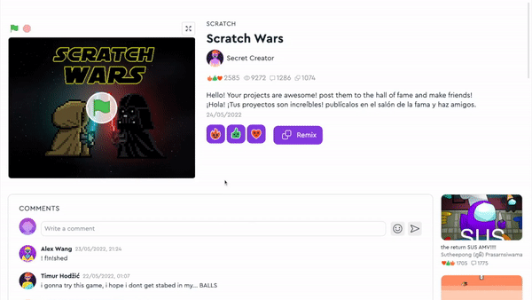
Projects
See the work of other students, play games.
Put reactions, share comments and discuss projects.
Hall of Fame

Slide 56
Hall of Fame rules
When you publish projects or write comments, make sure that you don't break the rules:
😇 | Politeness Do not scold or insult other students.
🤗 | Honesty Do not publish false information about events or people.
🕊 | Peace and friendship Don't add scenes of violence or crimes to your projects.
🚫 | No prohibited materials Do not publish indecent pictures, videos, text, etc.
For violating the rules, your access to the Hall of Fame will be restricted:
— for one week for the first violation,
— for two weeks for the second violation,
— for one month for the third and next violations, and we will also write to parents
Hall of Fame

Slide 57
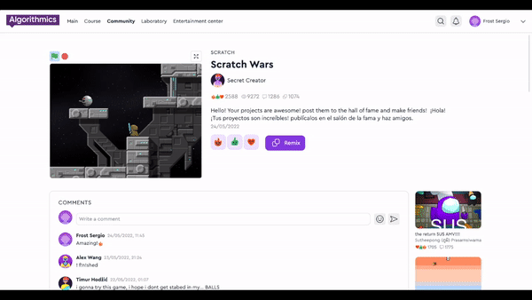

Full-screen project
It's easier to interact with projects if they are open in full screen mode.
To open the project, click on the arrow icon
Hall of Fame

Slide 58
Messages from the teacher and projects of classmates
My class

Slide 59
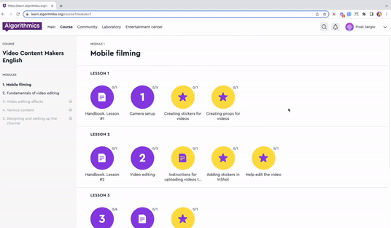
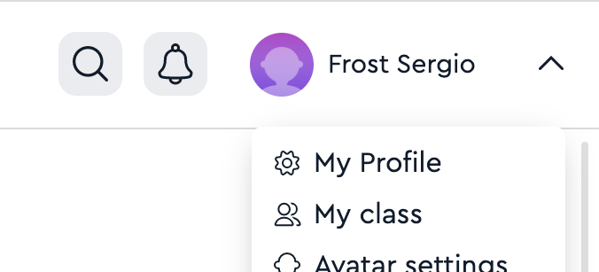
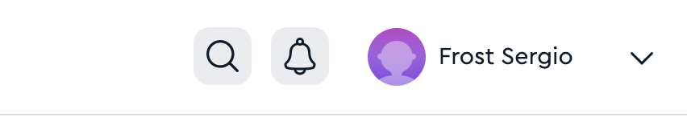
My class
The space in your classroom where you can publish and discuss projects with classmates, and view messages from the teacher.
1. Click on your name in the upper right corner
2. Click on the item
"My class"
Hall of Fame

Slide 60
Storing and viewing your projects
Laboratory

Slide 61
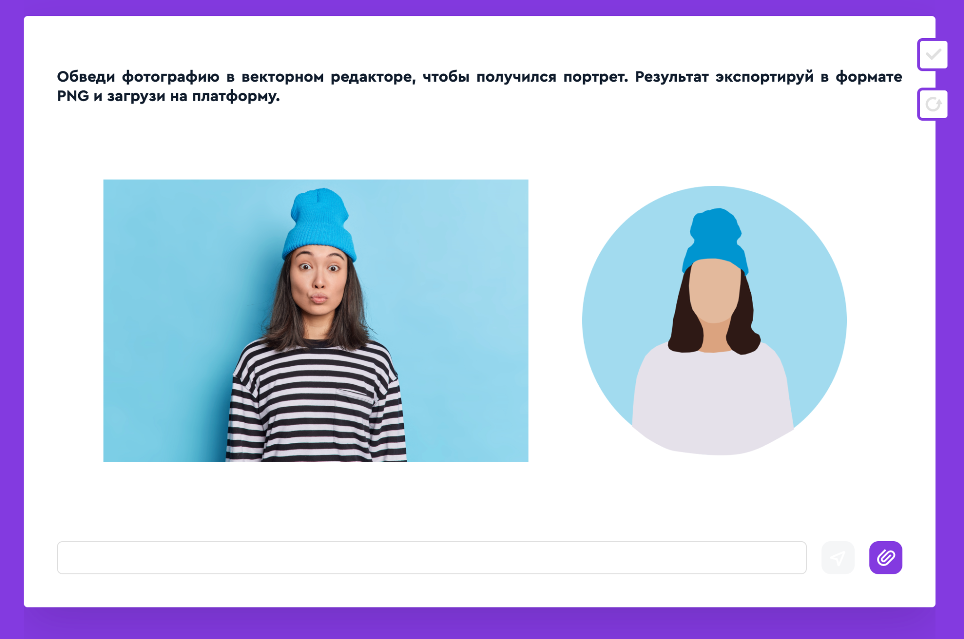

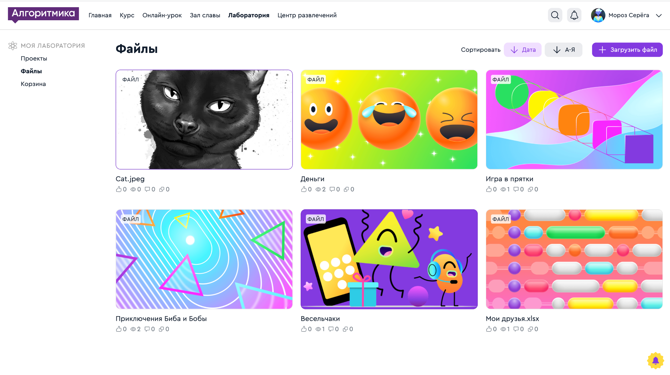
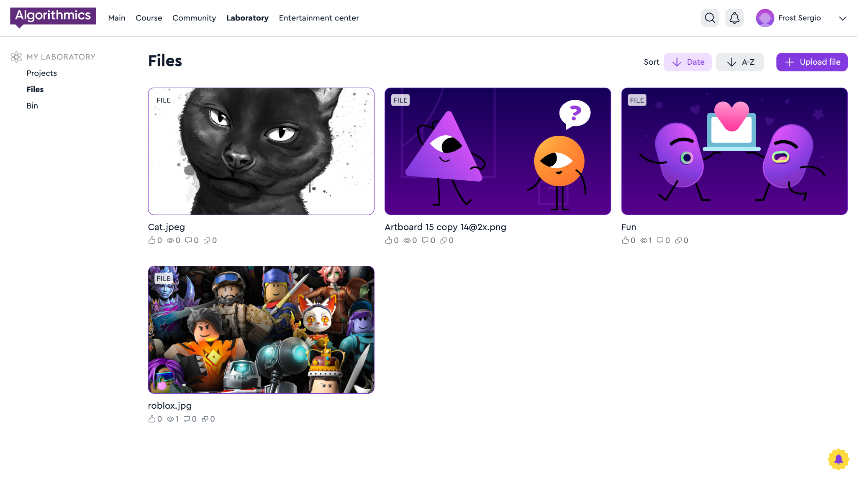
Your solutions are stored in the Lab
The files that you uploaded to the task on the platform go to the "Lab" on the "Files" tab.
Hall of Fame

Slide 62
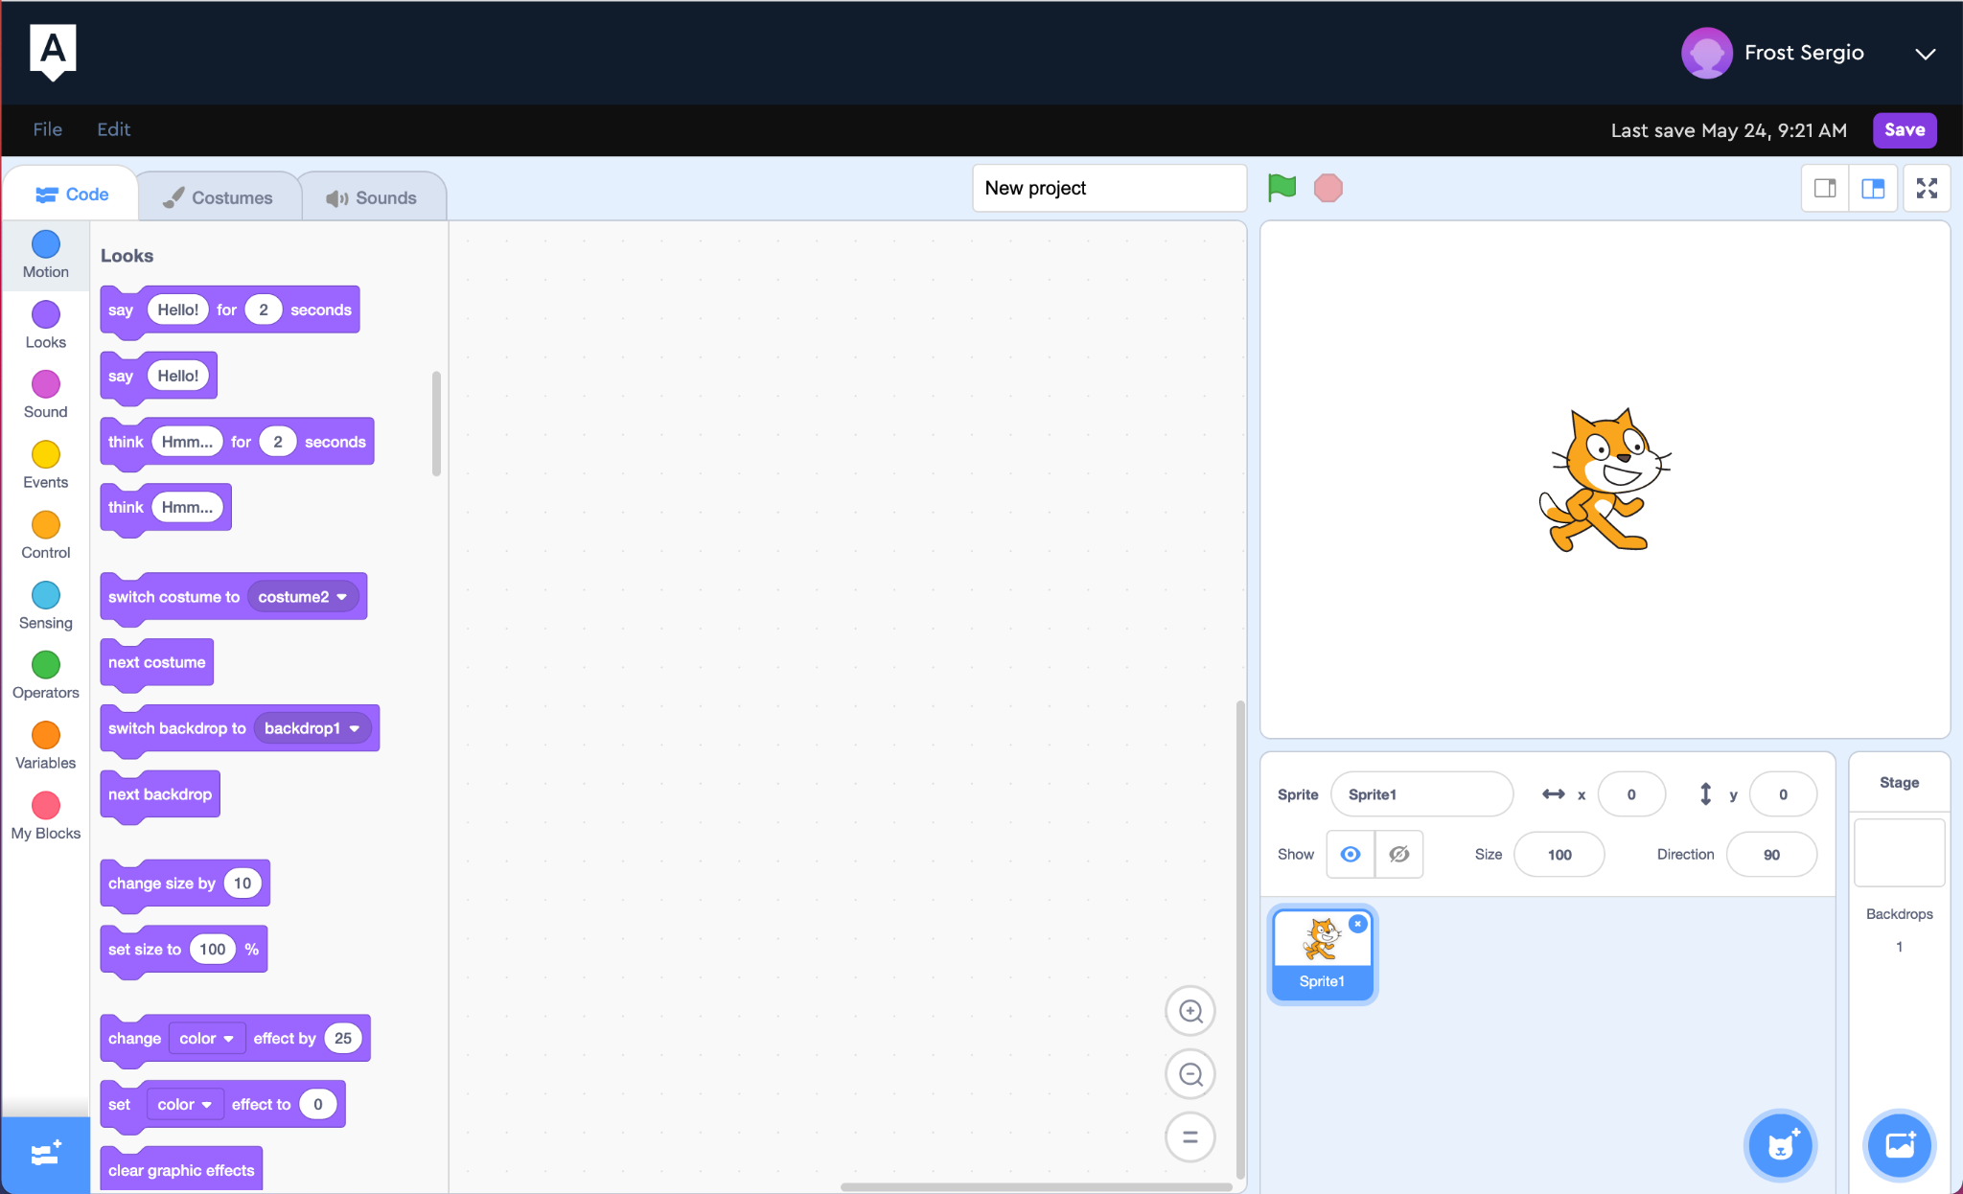
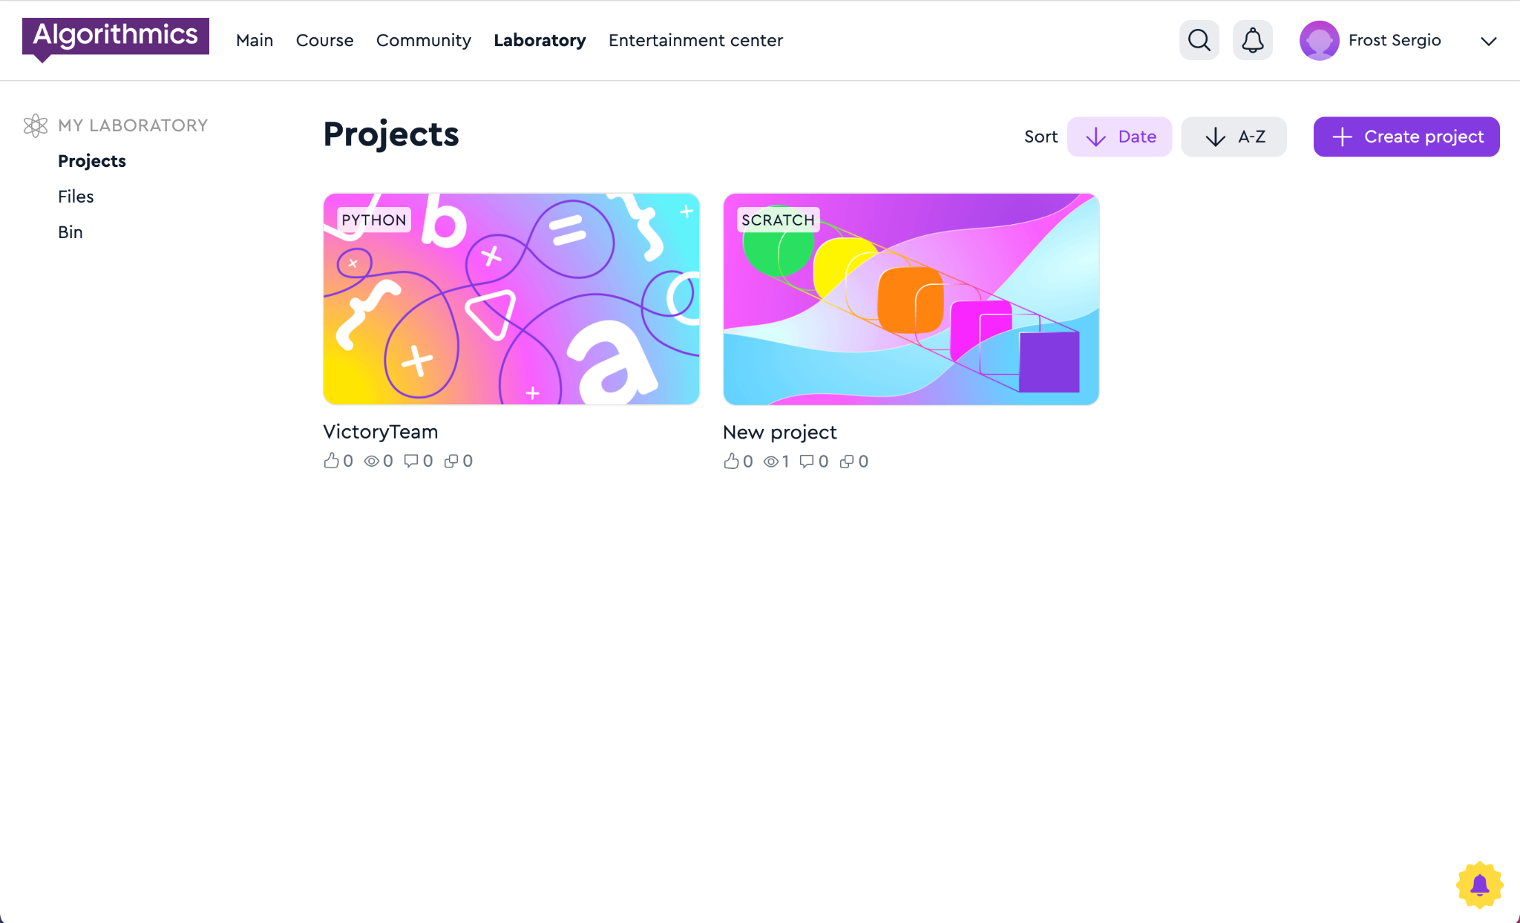
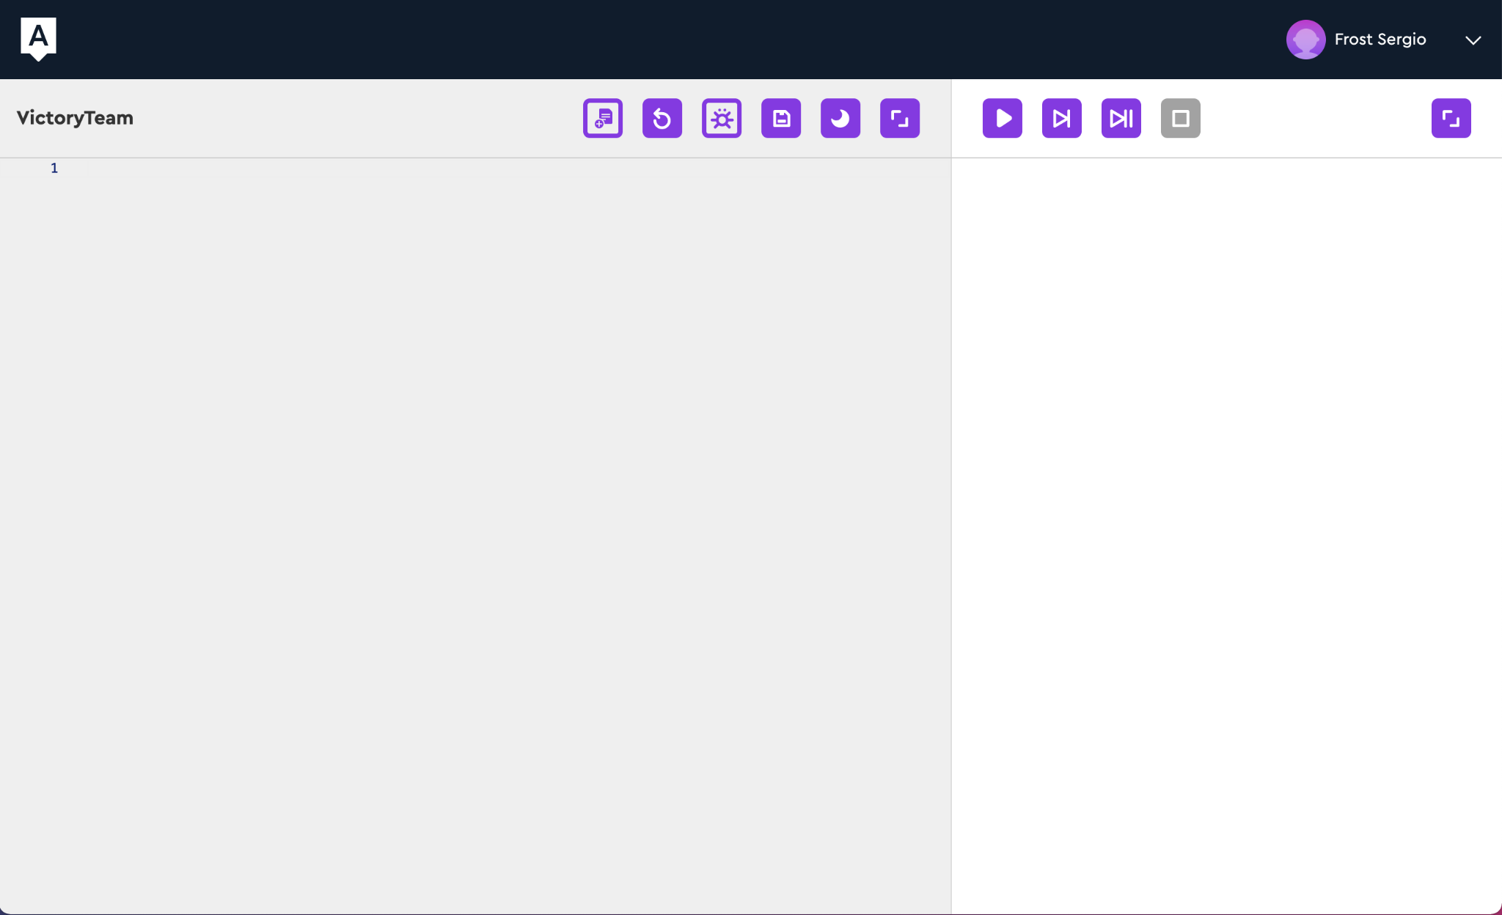
Your solutions are stored in the Lab
Scratch and Python solutions go to the "Lab" on the "Projects" tab immediately after saving.
Hall of Fame

Slide 63
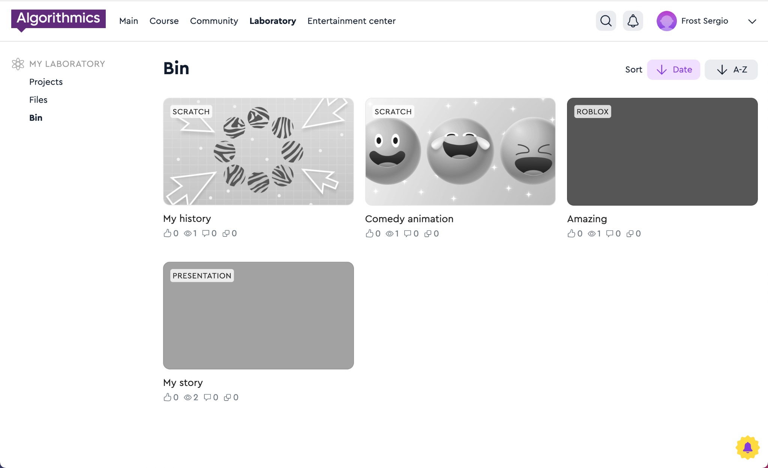
Deleted projects end up in the "Trash"
Hall of Fame

Slide 64
Publishing Python projects
Laboratory

Slide 65
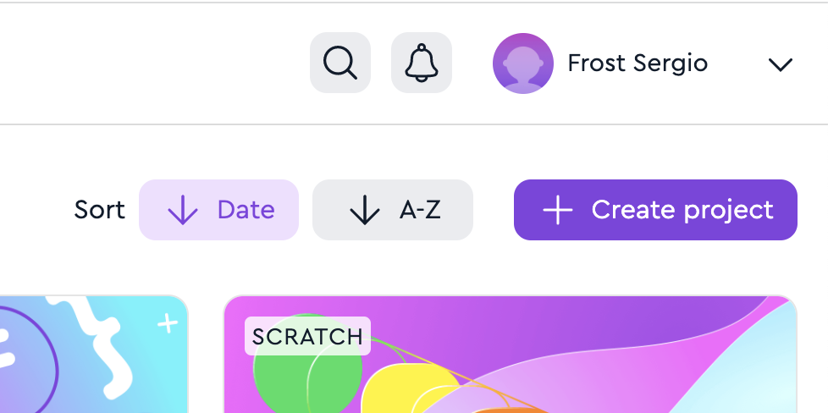
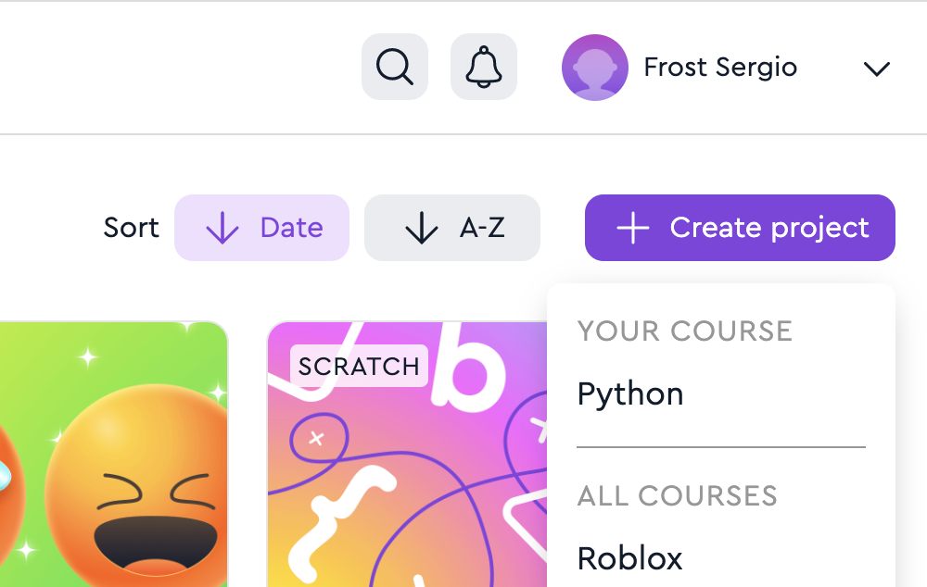
Create a project in the Lab
1. Go to the "Laboratory" page
2. Click on the button "+ Create project" → Python
Laboratory

Slide 66
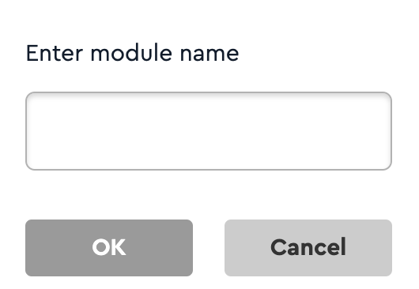
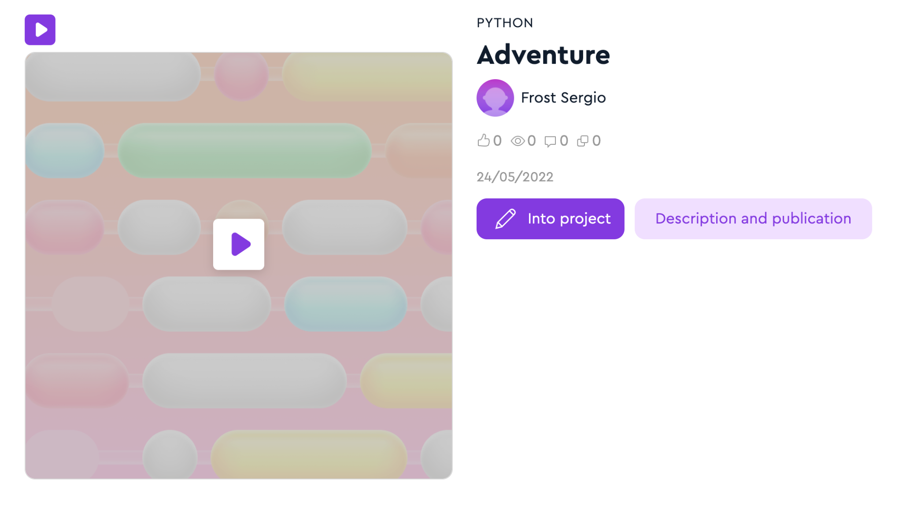
Add a name
3. Enter the project name Use only Latin letters, numbers and the sign "_" The name should not be the same as other names of projects on Python
4. Click "Description and publication"
Laboratory

Slide 67
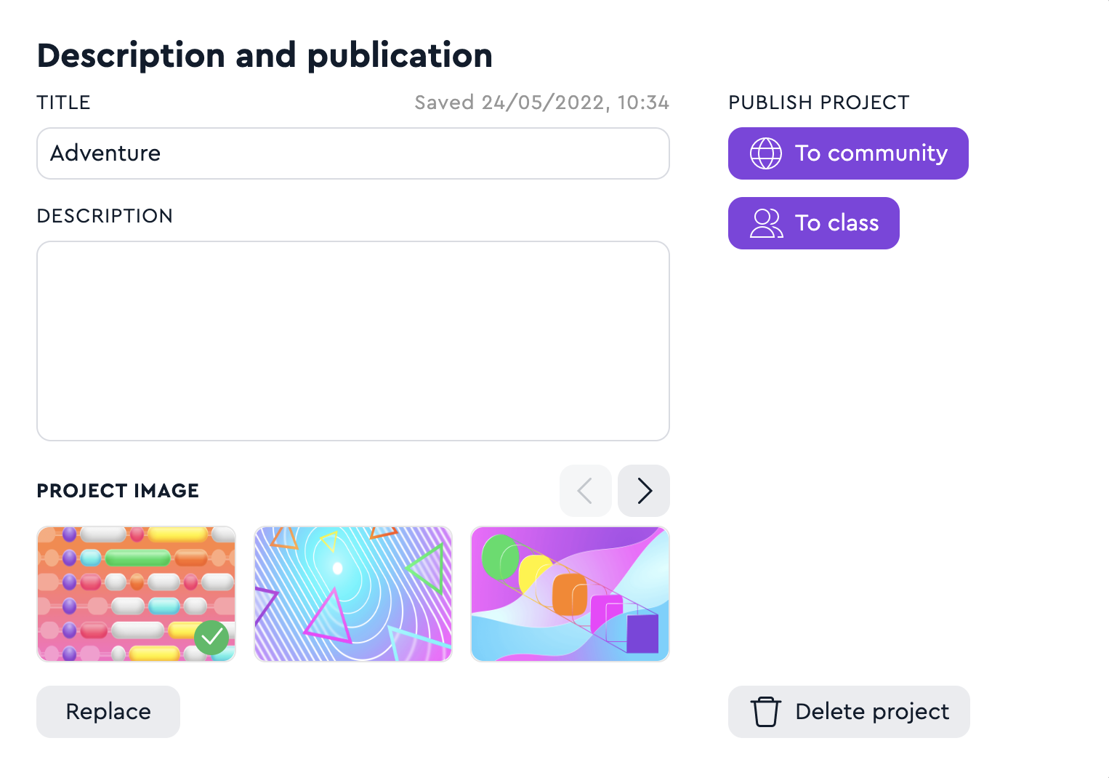
Enter a description and publish
5. Enter the name and description
6. Select and upload an image
7. Publish your project to the Hall of Fame or Class
Laboratory

